Slide 1
Automated Honey Extractor
Group 3
Dmytro Boichev
Petr Boychev
Kira Farney
Brandon Parmeter

Slide 2
Motivation
Beekeeping equipment, honey extractors in particular are very expensive.
Current lower-end beekeeping machinery (under $1500) is severely lacking in terms of performance.
The honey extraction process is too time consuming compared to other beekeeping duties.

Slide 3
Current Extractor Used
Current Extractor
Tangential Design
Frame Capacity: 2
Hand Operated
Stainless Steel

Slide 4
Goals and Objectives
Design and build a high performance automated honey extractor.
Extract honey with minimal input from the user.
Optimize and decrease time consumption of the honey extraction process.
Achieve the previous goal in under $1000.

Slide 5
Specifications
Component | Design Specification
Frame Holder | The extractor supports up to 15 frames.
Vat | The extractor has a vat capacity of 20 Gallons.
Heating System | The heating system maintains a vat temperature of 43 degrees Celsius.
Motor | The motor is capable of spinning the frame holder up to 250 RPM.
Wireless Connectivity | The extractor can be operated wirelessly from a distance of 30 feet.

Slide 6
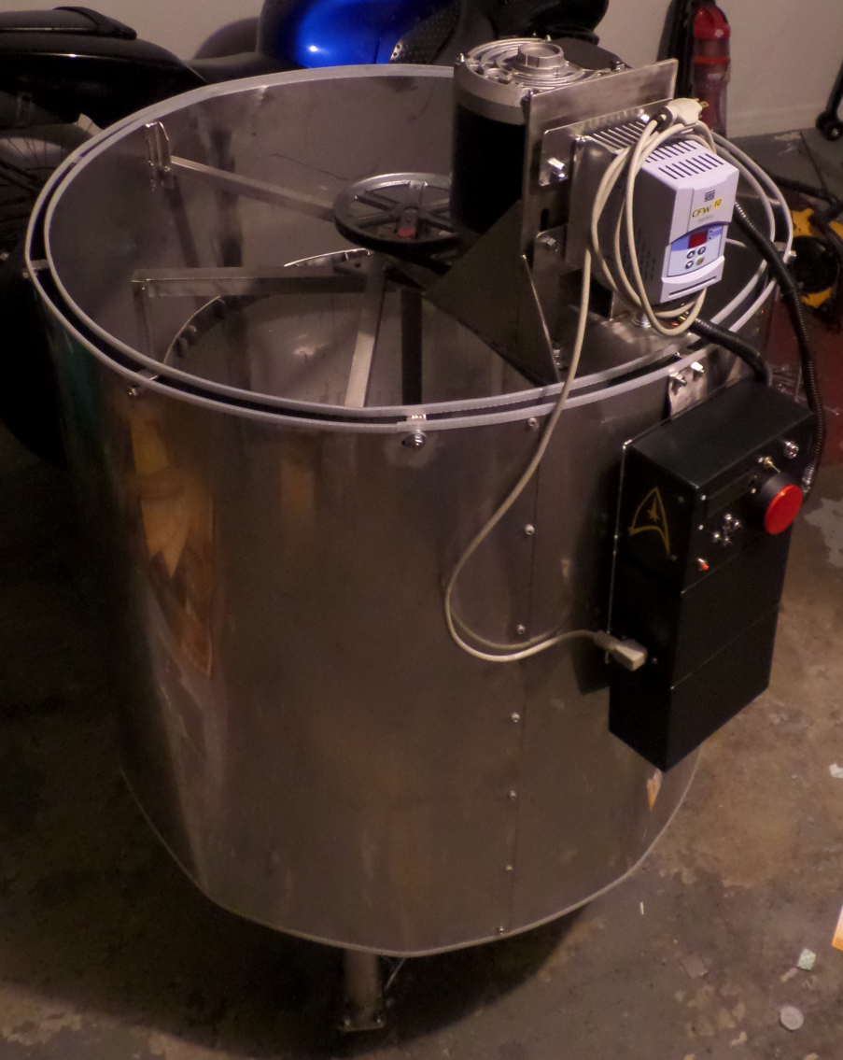
Mechanical Characteristics
Vat
Gauge 16 Grade 304 stainless steel with a bottom made of Gauge 13
Diameter: 32 inches
Height: 31inches
Total Volume: 24931.68 Cubic Inches (108 Gallons)
Usable Volume: 4608 Cubic Inches (20 Gallons)

Slide 7
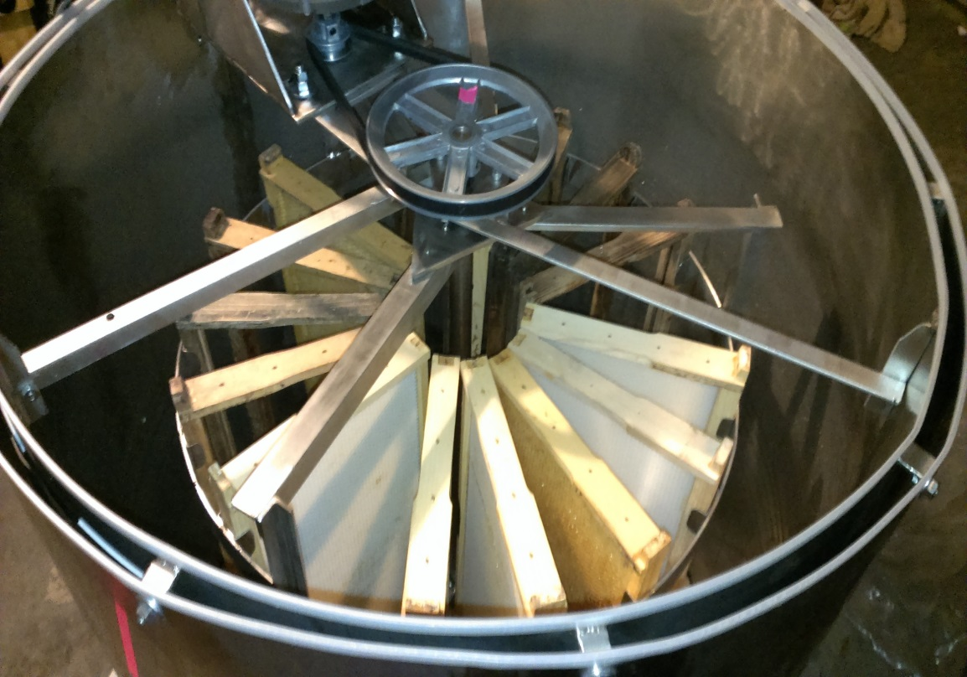
Frame Holder
Frame Holder
Radial Design
Grade 304 stainless steel
Radius: 13.5’’
Height: 31’’
Frame Capacity: 15
Shaft Diameter: 5/8’’

Slide 8
Block Diagram

Slide 9
Heating System

Slide 10
Heating System
The heating system speeds up the extraction process by decreasing honey viscosity.
Micro Controller
Temperature
Sensor
Heating Coil
Heating Coil Driver

Slide 11
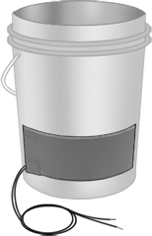
Heating Element
Flexible Silicone-Rubber Heating Sheet
Adhesive backed for easy installation
1” x 30” strip
115V @ 1.3 Amps x 3
Can be heated up to 149 ºC
150 x 3 Watt power capabilities

Slide 12
Sensors

Slide 13
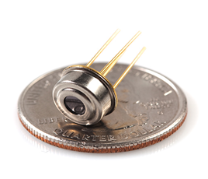
Temperature Sensor
An infrared temperature sensor provides feedback information to the heating system.
MLX90614
Temp range: -40°C ~ 125°C
Communicates via I2C interface
Voltage: 4.5 V ~ 5.5 V
Accuracy: ±1°C

Slide 14
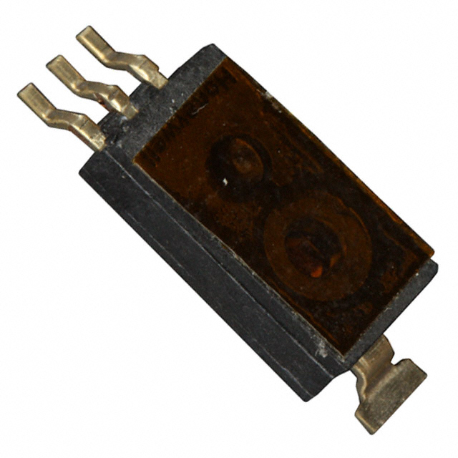
Humidity Sensor
Water content of the honey is affected by the humidity level during extraction.
High water content negatively affects the quality of the honey (leads to fermentation).
HIH-4030-003
Humidity Range: 0 ~ 100% RH
Operating Temp: -40°C ~ 85°C
Accuracy: ± 3.5% RH

Slide 15
Motor Controller

Slide 16
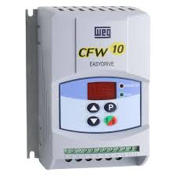
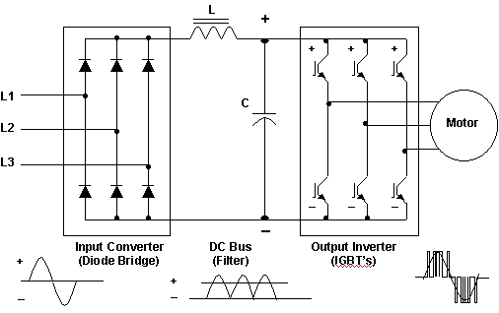
Motor Controller
Required motor output: ½ HP
AC motor used for availability of electrical power
Variable Frequency drive to slowly bring frame holder to extraction speed

Slide 17
Human Interface Device

Slide 18
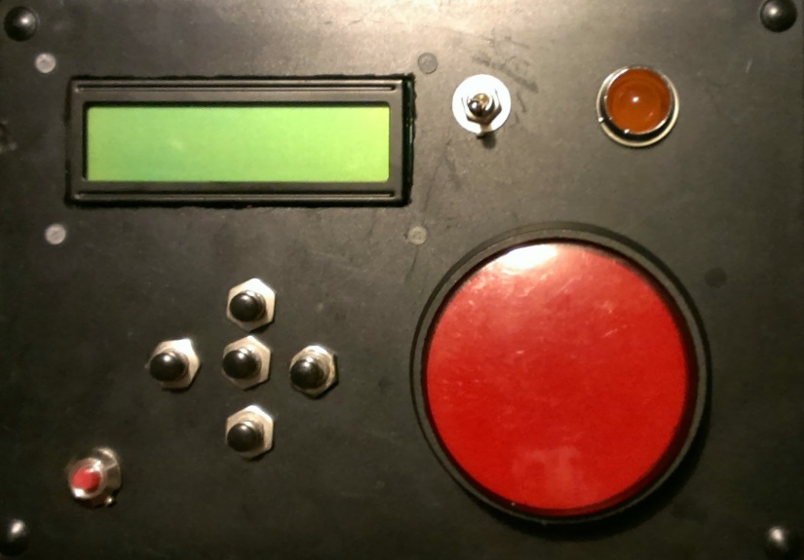
Human Interface Device
2 x 16 segment outdoor LCD display
Reads sensor data
Buttons and switches
Used to turn on and off device
Selects various operating modes
Select what is displayed on LCD

Slide 19
Microcontroller

Slide 20
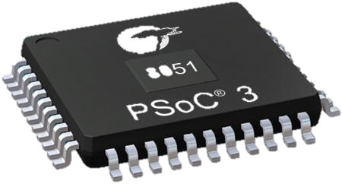
Microcontroller
PSoC 3
Delta Sig ADC
8-bit 8Msps DAC
Integrated LCD Driver
62 GPIO Pins
1.5 – 5.5 V operating range
Cheap $4.33

Slide 21
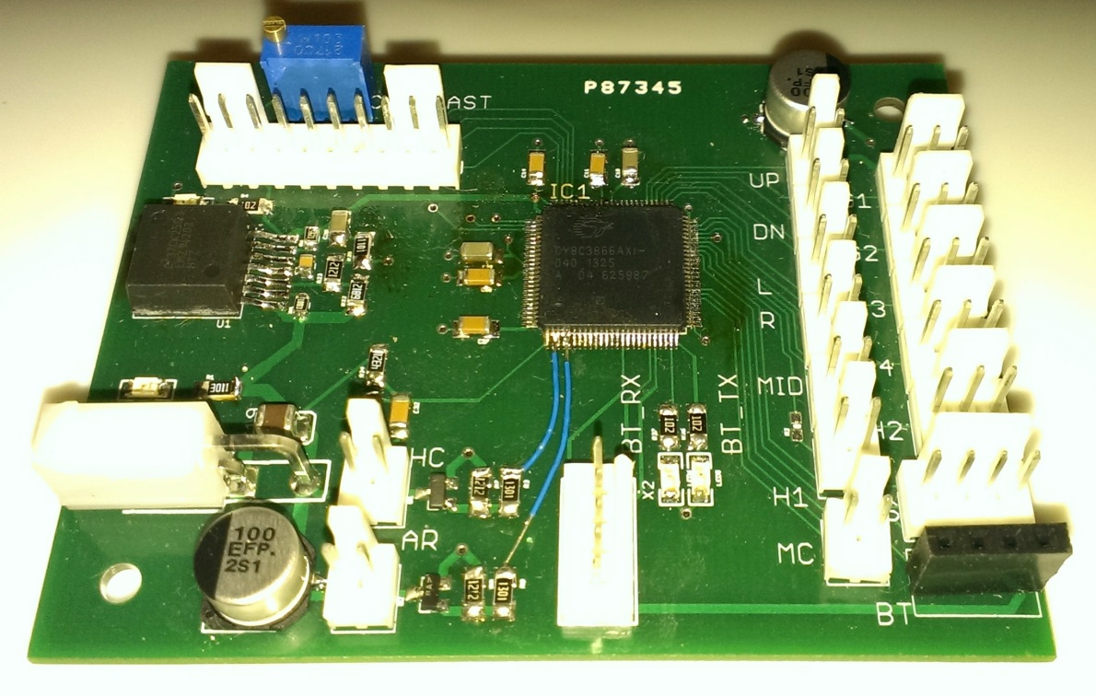
Printed Circuit Board
Integrated 5V supply
Easily connect various components
Humidity Sensor
Temperature Sensor
Bluetooth Module
LCD Display
Buttons
Motor Controller
Relay connections

Slide 22
Power Supply

Slide 23
Power Supply
Standard Wall Outlet 115V @ 60 Hertz
300 mA 12V DC power supply
Component | Voltage | Current | Type
Motor | 115V | 3A | AC
Heating Elements | 115 | 4A | AC
Printed Circuit Board | 12V | 300mA | DC

Slide 24
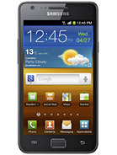
Remote Control

Slide 25
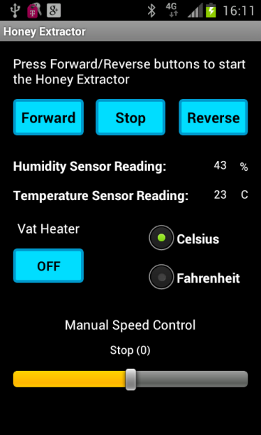
Android Development
Purpose:
Control the Honey Extractor remotely
Android development
Eclipse integrated development environment (IDE)
Minimum API level set to 8 (Android v2.2)
Target application programming interface (API) level 18 (Android v.4.3)
Developed on Android v.4.03
Tested on Android v.4.1.2 and v.4.3 platforms

Slide 26
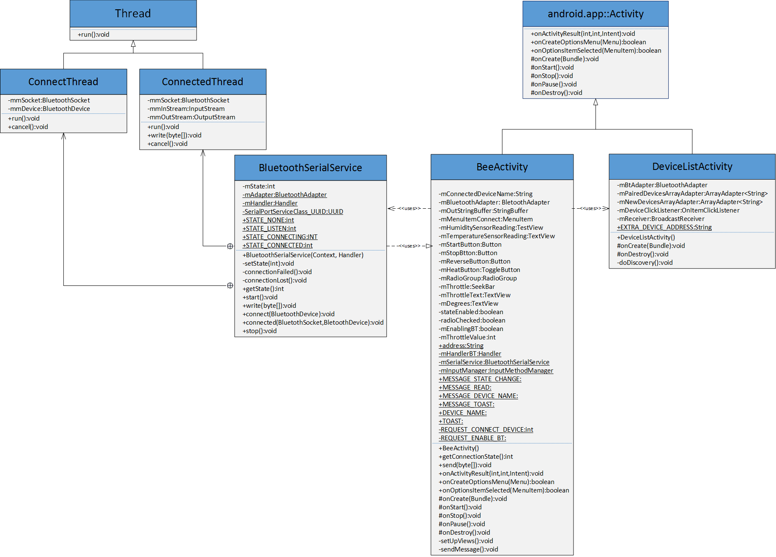
Android Development

Slide 27
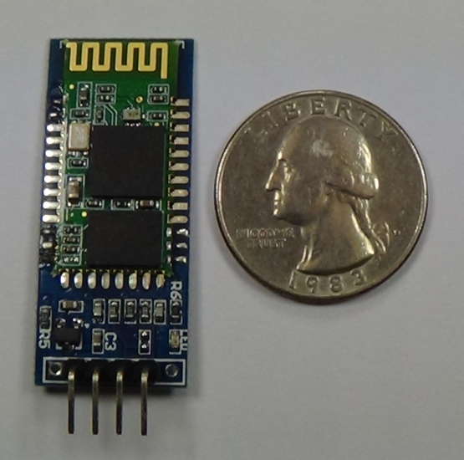
Bluetooth
Bluetooth HC-06 Slave module
Inexpensive
Operating range up to 10 m
Power supply 5V 50mA
Bluetooth v.2.0+EDR
Baud rate 9600 bps, 8 data bits, 1 stop bit, no parity bit communication format

Slide 28
Administrative Content

Slide 29
Work Distribution
 | Brandon | Dmytro | Kira | Petr
 | EE | EE | CpE | EE
Mechanical |  | X |  | X
Software | X |  | X
Power supply | X
Heating System | X | X |  | X
Sensors |  | X
BlueTooth |  |  | X
Motor | X |  |  | X
PCB design | X
Parts integration | X | X |  | X

Slide 30
Bill of Materials
Part | Cost
Mechanical Parts | $400.00
Humidity Sensor | $14.03
Infrared Temperature Sensor | $19.12
Motor | $59.04
Motor Controller | $85.48
Power Supply | $19.99
Printed Circuit Board | $84.99
Electronics | $120.12
BlueTooth Module | $10.60
Heating Element | $102.72
Valve | $15.00
Total | $887.09

Slide 31
Acknowledgements
Special thanks to:
Microflex Inc.
Robotics Club at UCF
Sergey Retinskiy
Petr and Dmytriy Boychev

Slide 32
Questions?

